Slide 1
What is API ?
API stands for Application Programming Interface
which is a mechanism that allows the interaction between two applications or it’s component using a set of rules.
Notes:
I have a piece of code which takes email id and fetch the profile details from my db. Now , we are creating a target mobile app which enables login platform for all the existing guests
at target.com using the app and fetch their profile details post successful login.
So now landing page has to integrate my piece of code with UI to get the profile details from DB , to do so I’ll expose an API that app can integrate.

Slide 2
What and Why REST ?
Common and widely used API’s are:
REST (Representational State Transfer): REST is not a protocol like the other web services, instead, it is a set of architectural principles. The REST service needs to have certain characteristics, including simple interfaces.
Support: json , text,html, xml.
SOAP (Simple Object Access Protocol): It uses only XML as a format to transfer data using WSDL(Web Services Definition Language).
XML tags and xml parser
Notes:
SOAP -> Legacy , you have deal with xml parser and to read the nodes that is adds complexity to consumers .
REST -> Modern and Flexibility >> it supports JOSN that I light weight and easy parsing while reading the response

Slide 3
REST Naming Convention and Standard
Should be Simple
Should be Intuitive
Sensitive information should not pass in service url
Appropriate http code should be used
Appropriate http method should be used
Notes:
v1/employee — a list of employee
v1/employee/1 — employee with an ID of 1
v1/employee/1/organizations — the organizations that user belongs to
An alternative would be using a query string for filtering:
v1/employee returns a list of all users
v1/employee?organisation=123 returns a list of users that are associated with that organisation

Slide 4
REST Methods
GET
POST
PUT
DELETE
PATCH
HEAD >> GET but not response body
TRACE >> Used to echo the contents of an HTTP Request back to the requester
CONNECT >>Used by the client to establish/test a network connection
OPTIONS >>Used by the client to find out the HTTP methods and other options supported by a web server.
Notes:
Explain : /{Path Variable}, ?Request Param, Header

Slide 5
HTTP CODES
1xx: Informational It means the request has been received and the process is continuing.
2xx:Success It means the action was successfully received, understood, and accepted.
3xx: Redirection It means further action must be taken in order to complete the request.
4xx: Client Error It means the request contains incorrect syntax or cannot be fulfilled.
5xx:Server Error It means the server failed to fulfill an apparently valid request.

Slide 6
REST idempotent
Idempotent : GET, PUT : WHY ?
GET If fired recursively /resource/123 it will give same result
PUT If fired recursively /user/123 it will give same result
NON Idempotent :DELETE ,POST : WHY ?
DELETE If fired recursively /user/123 it will give different result second time(404 or NOT_FOUND)
POST If fired recursively /user/(id is assigned by server) it will give different result every-time

Slide 7


Slide 8

What is SPRING ?

Slide 9
why SPRING ?
Notes:
Spring makes programming Java quicker, easier, and safer for everybody. Spring’s focus on speed, simplicity, and productivity has made it the world's most popular Java framework.

Slide 10
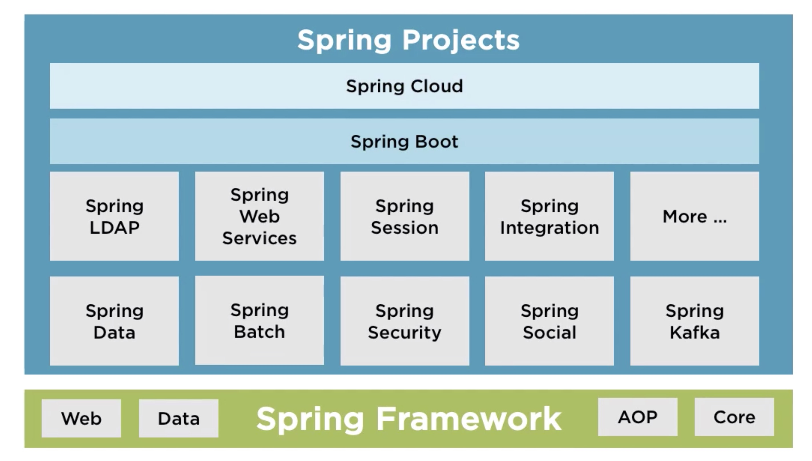

Slide 11

SPRING boot features

Slide 12

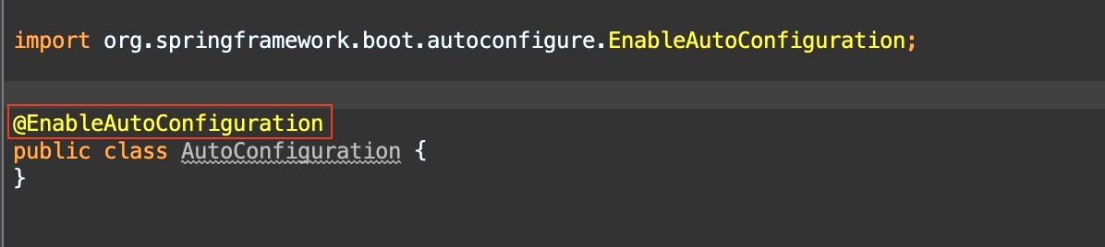
Auto-Configuration

Slide 13



Stand Alone

Slide 14

OPINIONATED

Slide 15
Ways to set up Spring boot project
Spring Boot initializer: https://start.spring.io/
Spring CLI
IDE’s

Slide 16


Slide 17
request flow
Front Controller
Controllers
Request
Delegates the
Request
Response

Slide 18
Spring beans
Container
Class A {
}
A
Beans
Class B {
}
Component Scan
B
Components
C
Class C {
}

Slide 19
@Configuration
@SpringBootApplication
@ComponentScan
@EnableAutoConfiguration

